Slide 1


Object Tracking
Christopher Caldarella
Data Scientist
2021-06-14
Notes:
Hello, My name is Christopher Caldarella, Data Scientist
And Today we will be looking at Object Tracking with Machine Learning

Slide 2
Is it possible to track a person and their movement with a moving camera?
Yes!
Notes:
Is it possible to track a person and their movement with a moving camera?
The answer is yes!
But I was hoping to try this with my son.
And I did, yesterday afternoon, and it worked ok!
However, this setup does require good placement, and I have not quite found that yet in my house.

Slide 3
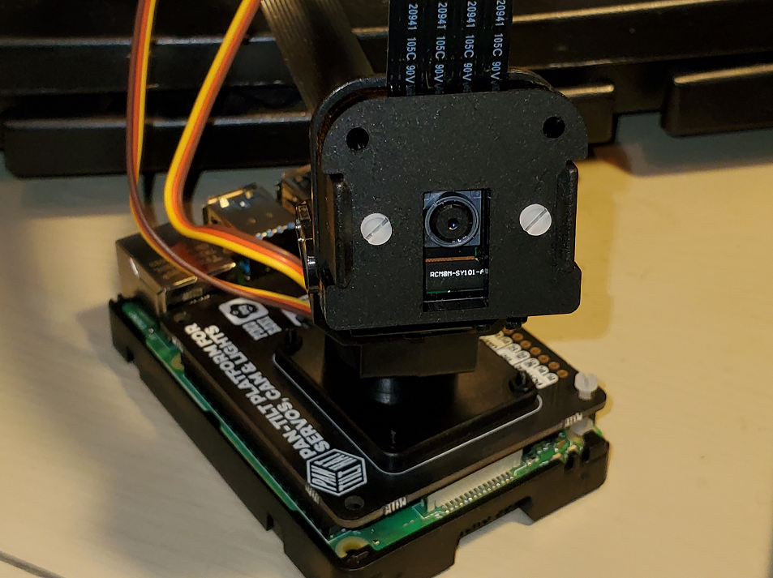
Overview
Hardware
Operating System
Environments
Machine Learning
Deep Learning
Notes:
This project had a lot of moving parts:
We had the Hardware:
Raspberry Pi: a small, relatively inexpensive computer
Pimoroni Pan-Tilt HAT: which sits on top of the Raspberry Pi, hence the term “hat“
The Pan-Tilt Hat is for tracking people or objects; it pans, and it tilts
Raspberry Pi Camera: self explanatory
Intel Compute Stick 2: an external USB processor for Neural Nets
The Operating System:
The Raspberry Pi generally runs on some flavor of Linux.
The Raspberry Foundation (a charity in the United Kingdom) has their own version of Linux
This is not impressive; apparently Hannah Montana and Justin Bieber have their own versions of Linux too.
I do not know why, but that is something I read on the internet, so it must be true!
Anyway, the Raspberry Pi OS is a branch from a popular Linux Ditro called Debian
Unfortunately it is only available in 32-bit at this time, so I could not take full advantage of the 4-core 64-bit processor.
Environments:
As we all know and love Anaconda, I had to install it on the Raspberry Pi.
Or at least I tried to.
Because of hardware restrictions, I had to install miniconda instead, which worked well!
I also found Venv to be useful for trying to install the Intel Compute Stick, but that didn’t pan out.
So in the end I used miniconda for this project.
Machine Learning:
I installed the OpenCV Library on the Raspberry Pi.
It is a computer vision Library written in C++, but also has bindings in Python, Java, and MatLab.
Using this Library I had access to some facial recognition algorithms, such as the Haar Cascade algorithm.
Deep Learning:
With some help I found the YOLO algorithm,
Which stand for You Only… LOOK Once.
Fortunately, OpenCV interfaces with YOLO, using the Darknet Distributed Neural Network
I will talk more about these algorithms in a moment.

Slide 4
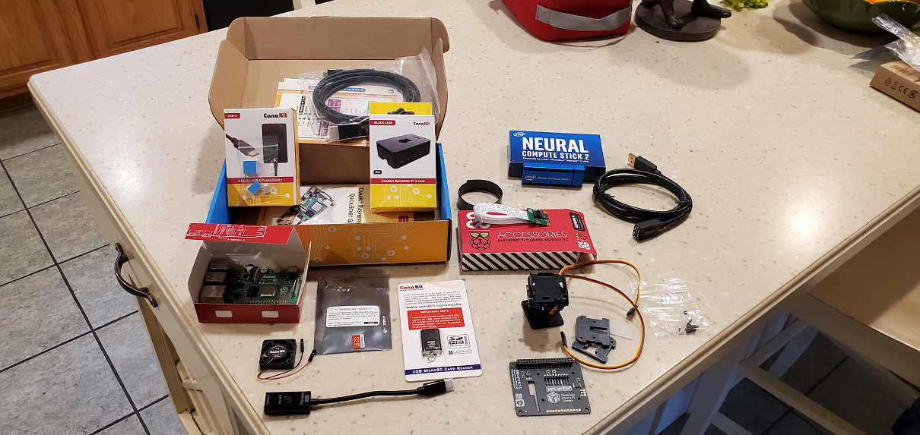

Making my Pi
Hardware
Operating System
Notes:
Hardware
I had to assemble the mess of stuff you see there on the left.
The Pan-Tilt HAT needed quite a bit of assembly
I ended up making a Blog post about it because the instructions were not great.
They were not bad either, they just lacked some detail.
The Raspberry Pi is actually somewhat simple to put together.
You put the OS on a microSD card and put the card in a slot in the front.
Then you plug in a mouse, keyboard, and monitor, and plug it into the wall and it is ready
The Operating System:
As I mentioned, the Raspberry Pi generally runs on some flavor of Linux.
And I mentioned that you need to put the OS on a microSD card
The process is actually quite easy, and just requires a card reader and an internet connection.
Raspberry Pi has a tool called “Imager” that you download and you tell it how you want to use the Raspberry pi.
I think you can even put your Wifi SSID and password in the app and it puts that information onto your installation
If anyone is looking for a fun project, I recommend grabbing one of these.
They make it very easy to use and they are generally not expensive.
And only every now and again will you question why you ever bought one and want to kick it across the room.

Slide 5
Object Detection Algorithms
2001
Haar Cascade
2013
HOG
YOLO (v1)
2015
Notes:
Haar Cascade
From a paper by Paul Viola and Michael Jones
"Rapid Object Detection using a Boosted Cascade of Simple Features".
Built off of the use of a Haar wavelet from a paper by Constantine P. Papageorgiou and others (1998, A General Framework for Object Detection)
HOG (Histogram of Oriented Gradients)
I did not use this and will not cover this much, but it is a popular Object Detection Algorithm and I wanted to show it in the timeline
From what I read, this is what SnapChat uses
This process basically calculates the gradient in 8x8 regions of a picture
By finding the direction the gradients are going in, you can capture the shape of objects.
YOLOv1
From University of Washington, Professor Joseph Redmon and some colleagues put out a paper in 2015,
"You Only Look Once: Unified, Real-Time Object Detection"
YOLO works by applying a single neural network to an image and breaking it into smaller regions
More notable iterations of the OLO algorithm are
YOLOv3 which was published in 2018 – also by Joseph Redmon and Ali Farhadi, and
YOLOv4 which was published in 2020 by Alexey Bochkovskiy and others
Both have a “tiny” version

Slide 6
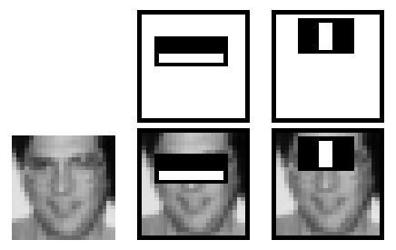
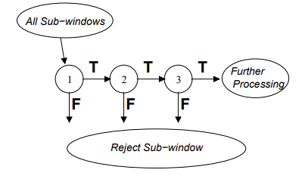
Haar Cascade
Haar Wavelet
Cascade with AdaBoost
Notes:
Haar Wavelet, which is a sequence of rescaled “square-shaped” functions, which Mr. Papa-Georgio used with support vector machines (or SVMs) to find important relationships between basis functions for object detection.
The Haar Wavelet is the Black and white rectangles in the pictures.
Viola and Jones took this idea and used the Haar Wavelet to find the sum of the pixels in the white square and subtract it from the sum in the black square.
This gave a better idea of features in a region instead of calculating a relationship between the pixels individually.
Since the eye region generally appears darker than surrounding areas such as the cheeks and the nose, this method is very good at detecting facial features.
The algorithm goes on to process the regions of the picture and discards any region that is not a Region of Interest (ROI)
This part is enhanced by using the AdaBoost Algorithm to construct strong classifiers as a combination of weaker classifiers

Slide 7
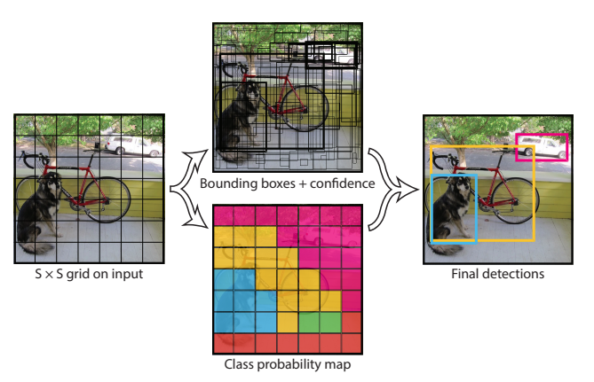
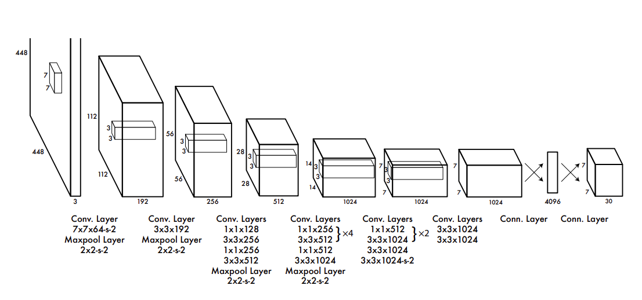
YOLO
One Neural Network
Predicts bounding boxes
Notes:
Since its first iteration in 2015, YOLO boasts the ability to
Process images in real-time at 45 frames a second, and the smaller version
Fast YOLO processes at 155 frames per second.
I unfortunately did not have that experience due to hardware constraints.
YOLO utilizes the open source Neural Network Framework, Darknet – also created by Joseph Redmon. It is written in C and CUDA
As I mentioned earlier, the YOLO algorithm uses one neural net (with Darknet), but as you can see, has many convolution layers
The neural network breaks the image apart into these smaller regions to predict bounding boxes and probabilities for each region.
The bounding boxes are weighted by the predicted probabilities.

Slide 8

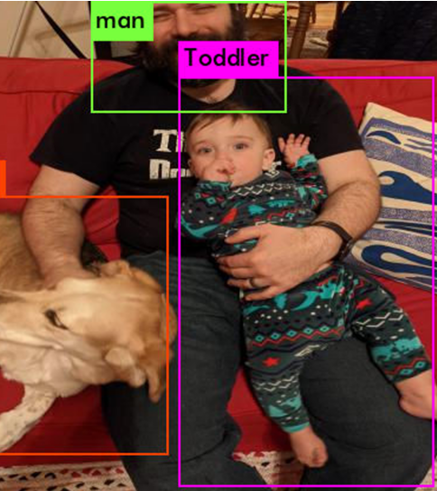
Using YOLOv4-tiny for full-body detection
Predicted in 11.278000 milli-seconds.
dog: 32%
man: 83%
Toddler: 69%
Notes:
First
Running in Google Colab

Slide 9
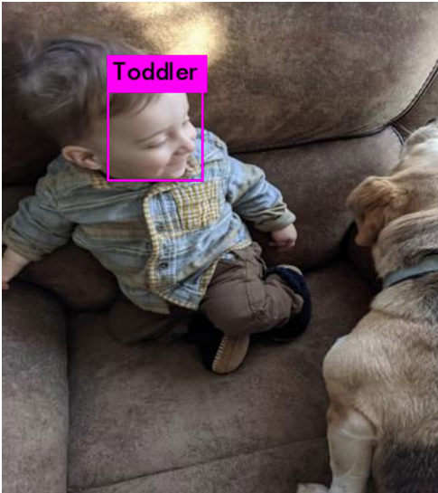
Using YOLOv4-tiny for Face Detection
Predicted in 5.150000 milli-seconds.
Toddler: 97%

Slide 10
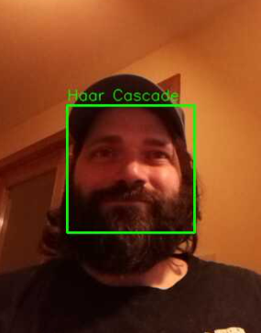
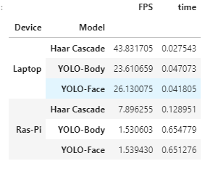
Haar Cascade

Slide 11
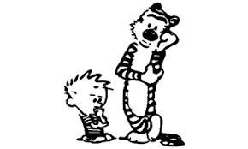
Questions?

